Slide 1
Optical imaging for brain tissue characterization using relative fluorescence lifetime imaging
Presenter : Manie Tadayon

Slide 2
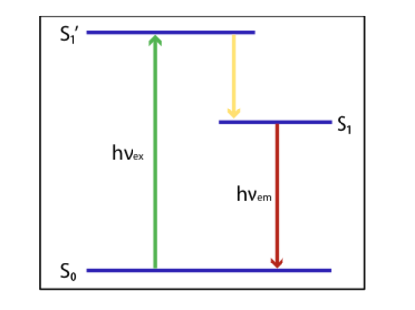
Principle of Fluorescence

Slide 3
Why Fluorescence Imaging ?
Normal and abnormal tissues
Cancer detection.

Slide 4
Different Types of Fluorescence Imaging
Steady State
Time Resolved

Slide 5
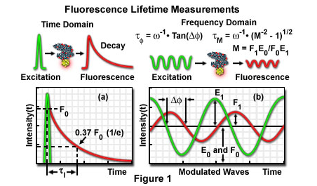
Techniques of Obtaining Fluorescence Lifetime Imaging
Time-domain FLIM
Frequency-domain FLIM

Slide 6
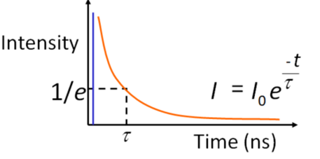

Why Do We Care about Lifetime ?
Exponential decay rate
Lifetime instead of intensity.

Slide 7
Conventional Fluorescence Lifetime System
Sampling
Curve Fitting
Post processing

Slide 8

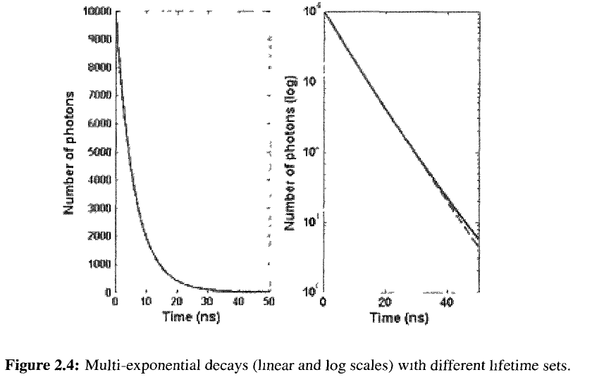
Identifying Multiple Lifetime
Curve Fitting issue
Not Identifiable

Slide 9
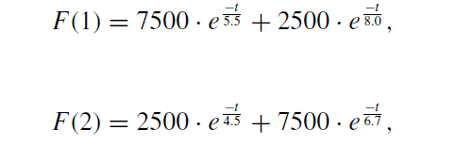
Identification of Multiple Lifetime Difficulty Example
J. Lakowicz, “Time-domain lifetime measurements”

Slide 10
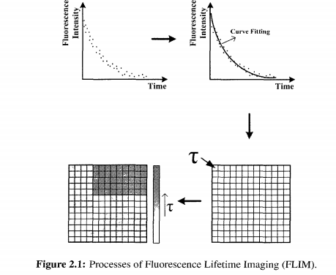
Processes of Fluorescence Lifetime Imaging

Slide 11
Relative Lifetime of Fluorescent images
Differences in lifetimes.
Relative life time images.
Contrast by maps of differences in decay of tissue

Slide 12
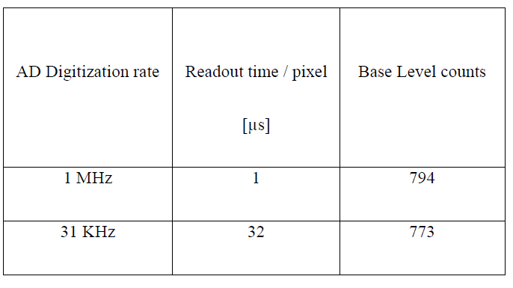
ADC Characteristics

Slide 13
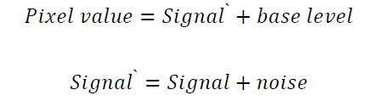

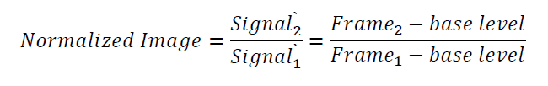
Image Normalization Algorithm

Slide 14
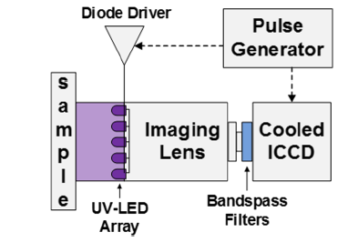
Wide-Field Time Domain FLIM

Slide 15
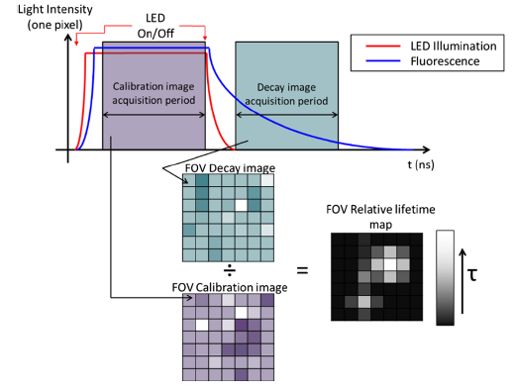
Relative Fluorescent Lifetime Algorithm

Slide 16
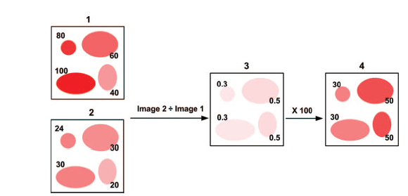
Graphical Illustration of Obtaining Relative Lifetime Images

Slide 17
Advantage of Using Relative Fluorescent Lifetime Algorithm
Pixel-wise division
Processing time.
Signal to noise ratio

Slide 18
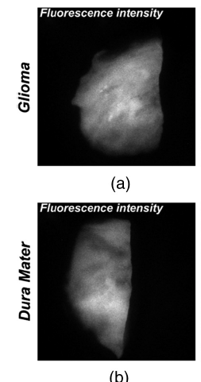
Fluorescence Intensity Images of the “calibration image”
Large sensitivity range
Intensity .

Slide 19
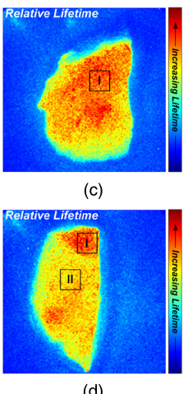
Custom Color Map of Relative Lifetimes Images
Customized Lookup Table
Life time
(c) Glioma (d) Dura Matter

Slide 20
Thank You

